Slide 1

HR Analytics : Employee Attrition
Aishwarya Choudhary
Siddharth Naik
Aishwarya Choudhary
Siddharth Naik
"You don't build a business. You build people, and people build the business." - Zig Ziglar

Slide 2
Motivation :
Employee turnover is a costly problem.
True cost of replacing an employee can be large.
Understanding WHY and WHEN employees are most likely to leave can lead to actions to improve employee retention.

Slide 3
Project objective:
Using SAS to study the characteristics of Employees that are more prone to leaving or turn-over.
Notes:
In the process we are going to apply different ML techniques.

Slide 4
Project Flow
DATA DESCRIPTION
DATA CLEANING
DATA EXPLORATION
MODEL BUILDING
Logistic regression
Decision Trees
Notes:
Data Cleaning - Identification of any irregularities and handling it.
There may be another arrow depending on if we come up with some insights

Slide 5
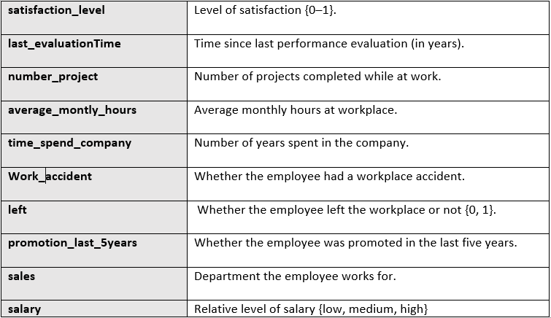
DATA DESCRIPTION
Dimensions:
14999 x 10

Slide 6
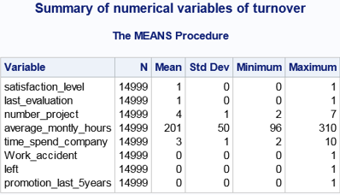
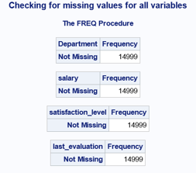
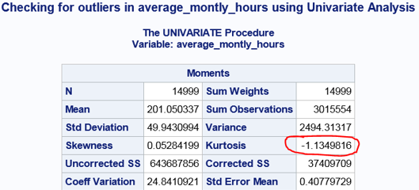
DATA CLEANING
Missing Values
No Missing values found
Outliers
Low kurtosis tend to have light tails, or lack of outliers

Slide 7
DATA EXPLORATION

Slide 8
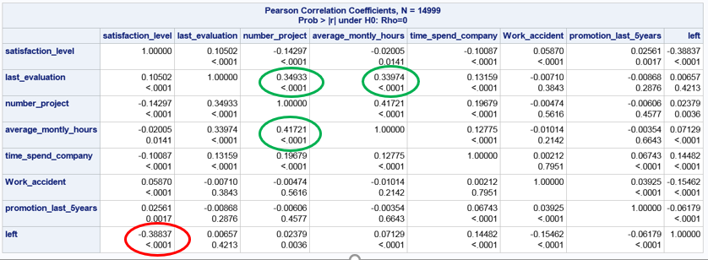
Correlation
No case of Multicollinearity
Moderate Positively Correlated Features:
projectCount vs evaluation: 0.349333
projectCount vs averageMonthlyHours: 0.417211
averageMonthlyHours vs evaluation: 0.339742
Moderate Negatively Correlated Feature:
satisfaction vs left: -0.388375
Notes:
Moderate Positively Correlated Features:
projectCount vs evaluation: 0.349333
projectCount vs averageMonthlyHours: 0.417211
averageMonthlyHours vs evaluation: 0.339742
There is a positive(+) correlation between projectCount, averageMonthlyHours, and evaluation. Which could mean that the employees who spent more
hours and did more projects were evaluated highly.
Moderate Negatively Correlated Feature:
satisfaction vs left: -0.388375
left and satisfaction are highly correlated. I'm assuming that people tend to leave a company more when they are less satisfied.

Slide 9
GRAPHICAL EXPLORATION

Slide 10
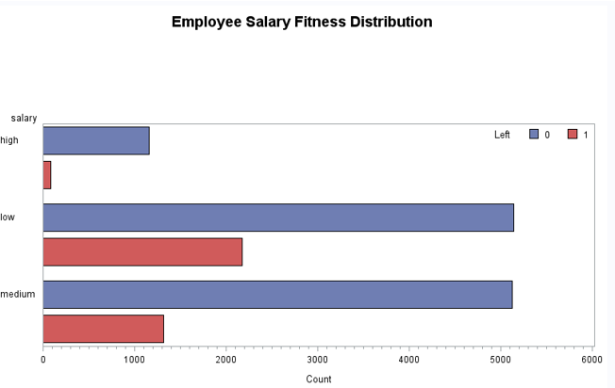
Salary vs Turnover
Majority of employees who left either had a low or medium salary.
Barely any employees left with high salary
Employees with low to average salaries tend to leave the company.

Slide 11
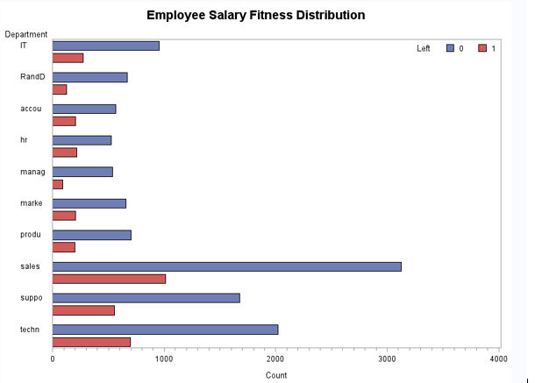
Department VS Turnover
Highest turnover - Sales, support, technical
Lowest turnover - Management

Slide 12
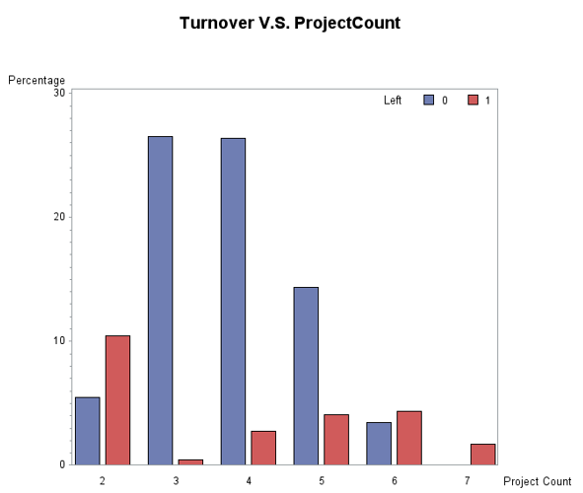
Turnover V.S. ProjectCount
There is an increase in employee turnover rate as project count increases.

Slide 13
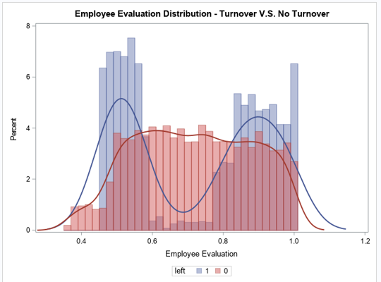
Turnover V.S. Evaluation
The sweet spot for employees that stayed is within 0.6-0.8 evaluation.

Slide 14
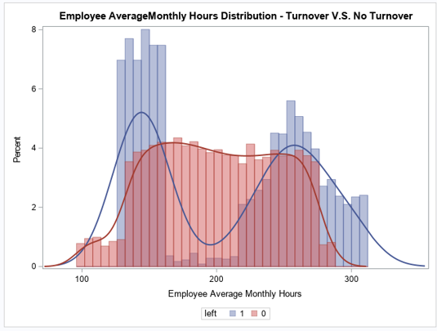
Turnover V.S. AverageMonthlyHours
Employees who left generally were underworked or overworked.

Slide 15
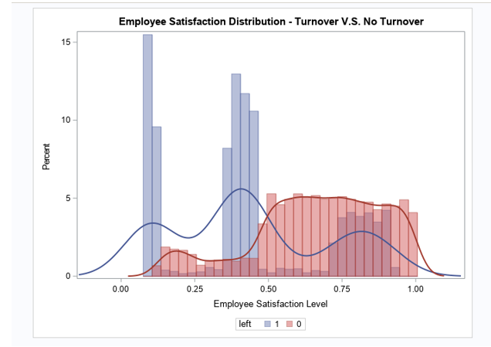
Turnover V.S. Satisfaction
Employees who had really low (0.15 or less) or low (0.3~0.5)satisfaction levels left the company more.

Slide 16
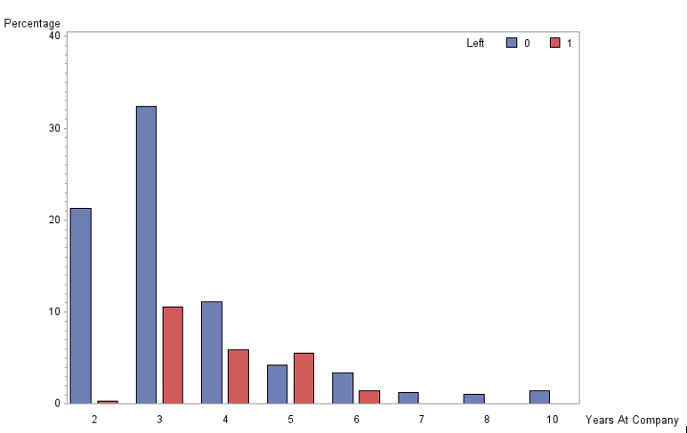
Turnover V.S. YearsAtCompany
Employees with 4 and 5 years should highly be looked into.

Slide 17
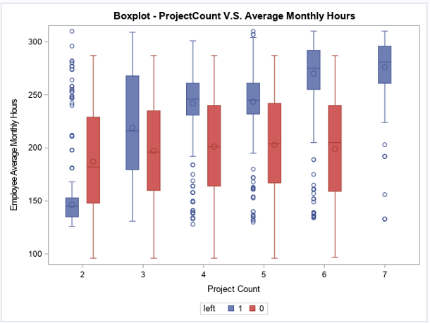
ProjectCount VS AverageMonthlyHours
Employees who did not have a turnover had consistent averageMonthlyHours, despite the increase in projects.
In contrast, employees who did have a turnover had an increase in averageMonthlyHours with the increase in projects.

Slide 18
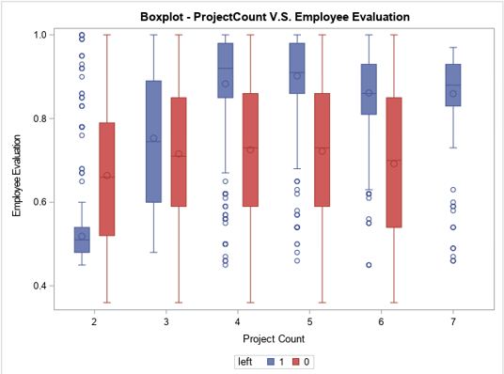
ProjectCount VS Employee Evaluation
There is an increase in evaluation for employees who did more projects within the turnover group.
Again for the non-turnover group, employees here had a consistent evaluation score despite the increase in project counts.

Slide 19
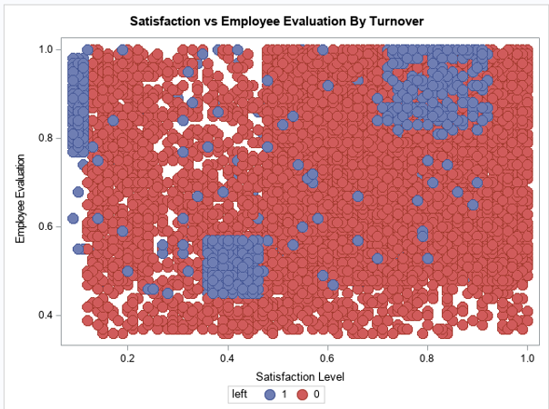
Satisfaction V.S. Evaluation
Hard-working and Sad Employee
Bad and Sad Employee
Hard-working and Happy Employee

Slide 20
LOGISTIC REGRESSION
Build a Model to Predict which employee is prone to leaving

Slide 21
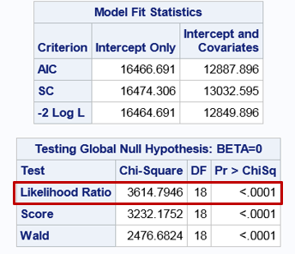
The likelihood ratio chi-square of
3614.7946 with a p-value of 0.0001
tells us that our model fits
significantly better than a null model.

Slide 22
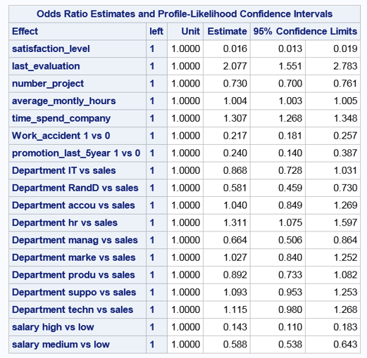
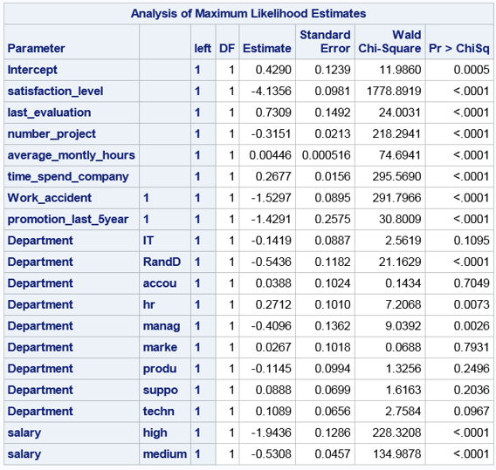
Model
Retention Plan :
> Employees who have had a promotion in last 5 years have 76% lower odds of leaving as compared to those who have not been promoted.

Slide 23
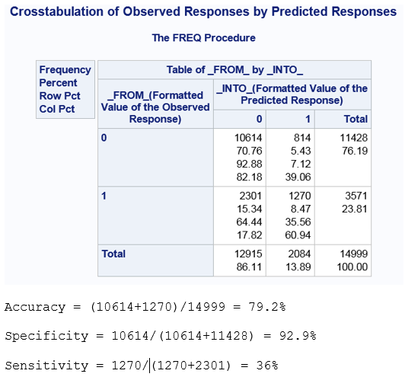
Model Accuracy
Drawback : Low Sensitivity

Slide 24
Decision Tree
Employee Turnover - Classification Model

Slide 25
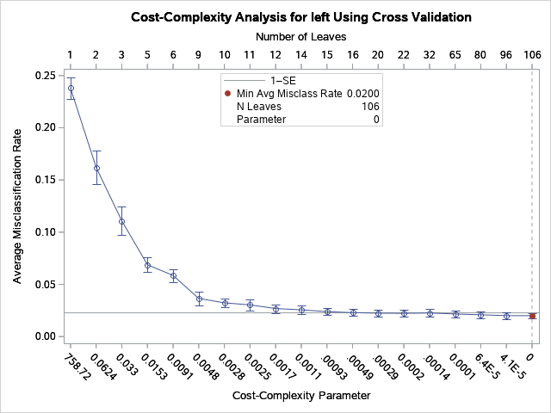
Cost Complexity Curve - Employee Turnover

Slide 26
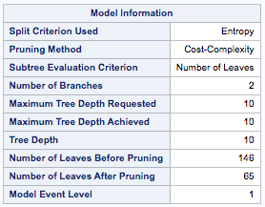
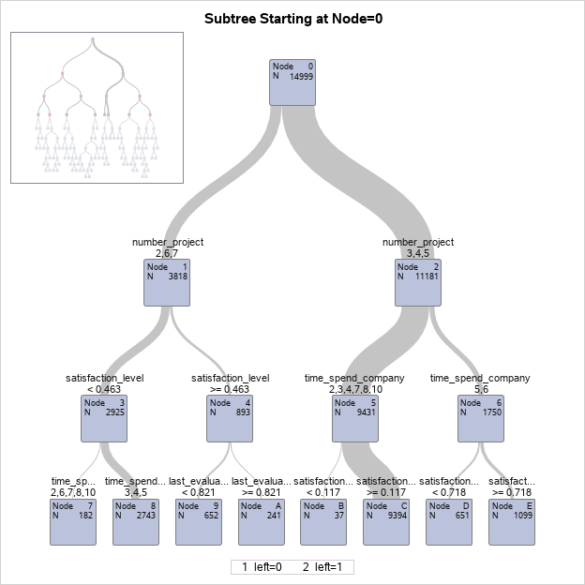
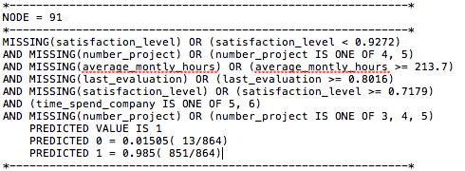
Tree Output - HPSPLIT Procedure

Slide 27
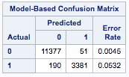
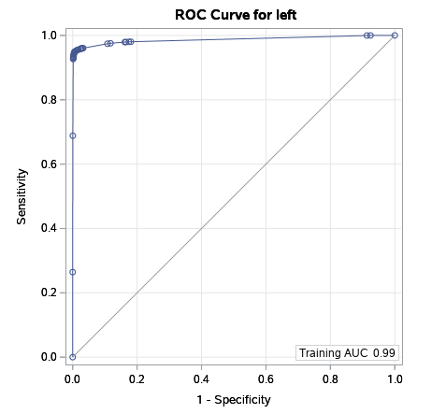

Confusion Matrix & ROC Curve

Slide 28
Questions ?

